Slide 1



Elite Rentals
Not just your wheels, your journey.

Slide 2
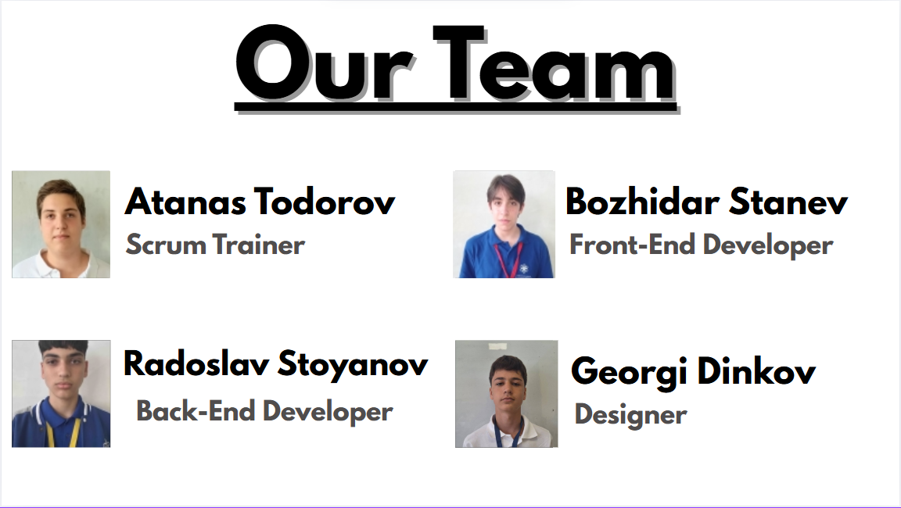



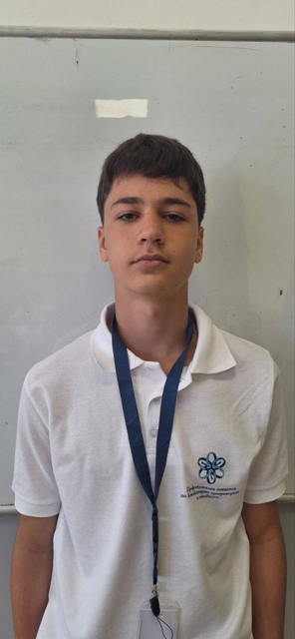
Our Team
Atanas Todorov
Bozhidar Stanev
Scrum Trainer
Front-End Developer
Radoslav Stoyanov
Georgi Dinkov
Back-End Developer
Designer

Slide 3
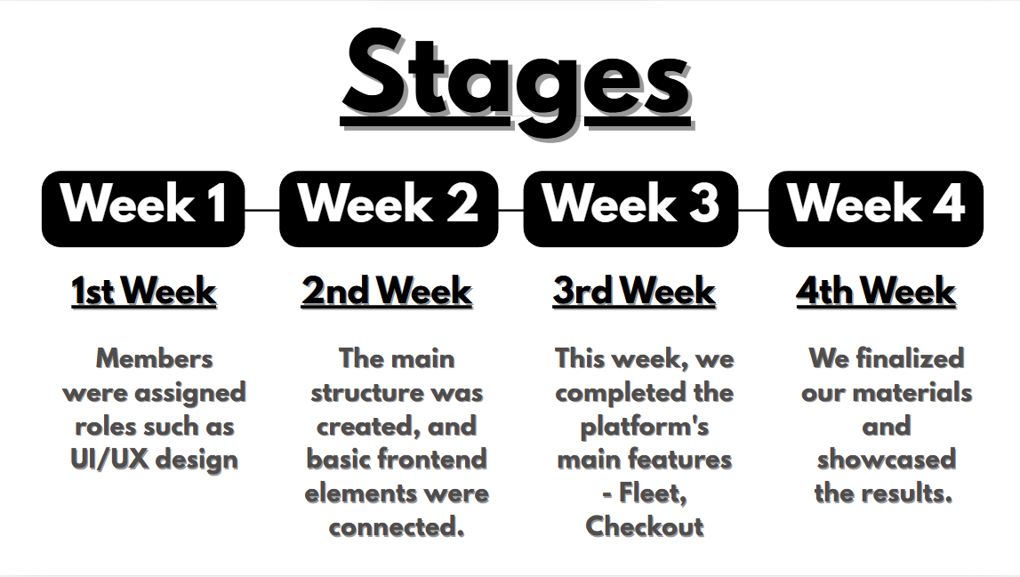
Stages
Week 1
Week 2
Week 3
Week 4
1st Week
2nd Week
3rd Week
4th Week
Members were assigned roles such as UI/UX design
The main structure was created, and basic frontend elements were connected.
This week, we completed the platform's main features - Fleet, Checkout
We finalized our materials and showcased the results.

Slide 4


Used Technologies

Slide 5
Let’s Get To The Website!

Slide 6
Work Flow
Our Designer is responsible for designing and enhancing the platform’s interface. They work closely to make sure the UI of the website meets standarts, identify needs and improve features, ensuring the user experience is ideal.

Slide 7
Work Flow
The Development Team manages the technical side, building and maintaining the platform’s back-end. They focus on ensuring the system is stabl and appealing, providing updates and handling the functionality.

Slide 8
Our Focus
A challenge was creating a platform that was user-friendly. Our Development Team had to balance functionality, ensuring the system could handle changes while maintaining a smooth interface. Through communication with the Team, we were able to continuously test, reworking features based on ideas and feedback from our mates.

